Slide 1
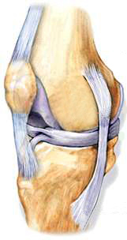
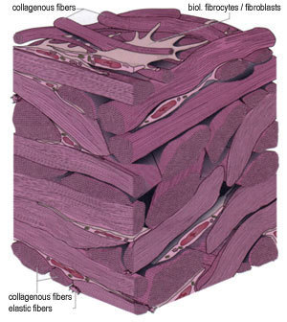
Types of connective tissue :
iii. Ligaments :
It connects bones and is very elastic with considerable strength.
Ligament contains very little matrix.
It serves to hold the structures together and keep them stable.
Ligaments

Slide 2
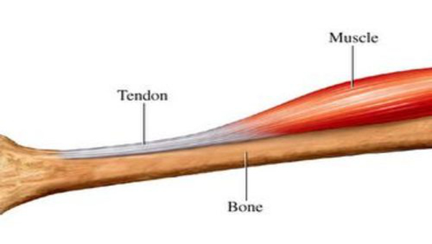
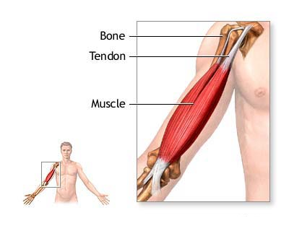
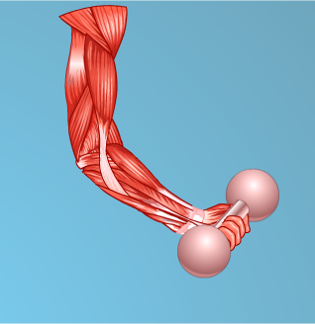
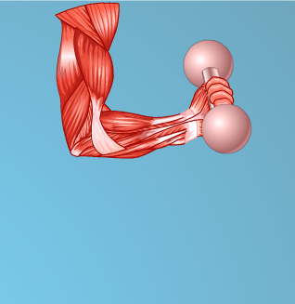
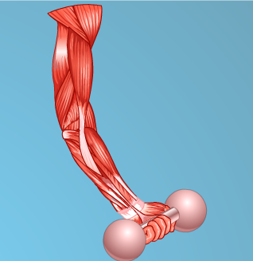
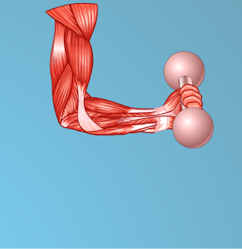
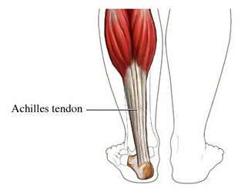
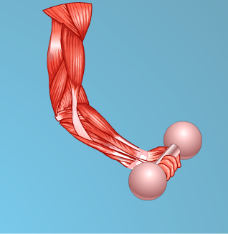

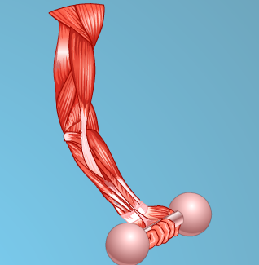
Types of connective tissue :
iv. Tendons :
It connects muscles to the bones.
Tendons are fibrous with great strength, but have limited flexibility.
Tendons serve to move the bones or structure.
For example in human beings muscles of calf are attached to the heel bone.

Slide 3
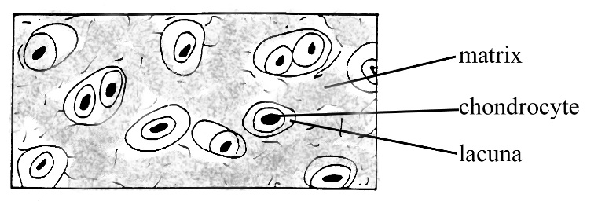
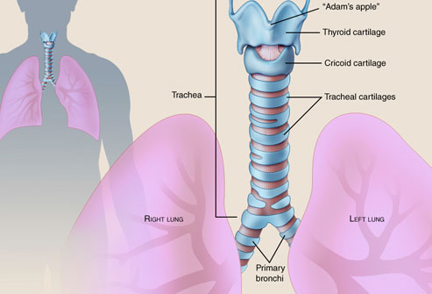
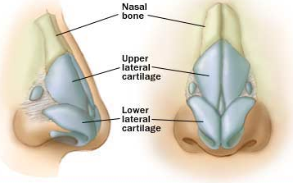
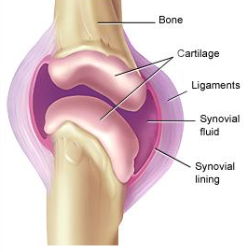
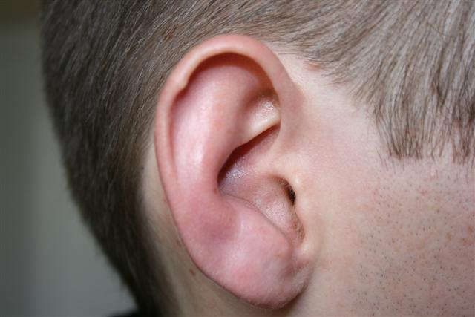
Types of connective tissue :
v. Cartilage :
Its cells are widely spaced.
It has solid matrix which is composed of proteins and sugars
Cartilage smoothens the bone surface at joints.
It is also present in the nose, ears, trachea and larynx.
Away from each other
Wind pipe
Voice box

Slide 4
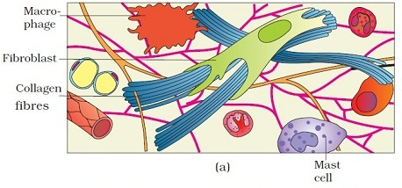
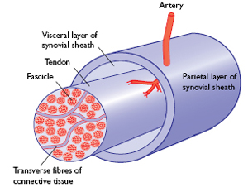
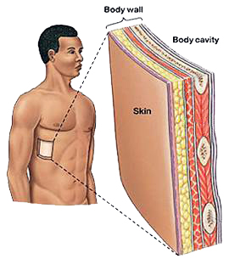
Types of connective tissue :
vi. Areolar tissue :
It is found between skin and muscles, around blood vessels, nerves and in the bone marrow.
It fills the space inside the organs and supports internal organs and helps in repair of tissue.
Areolar tissue

Slide 5
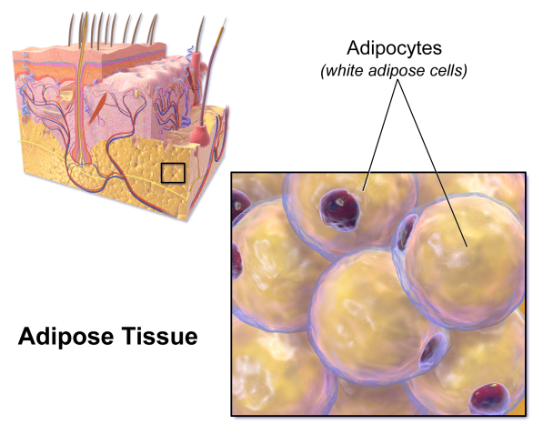
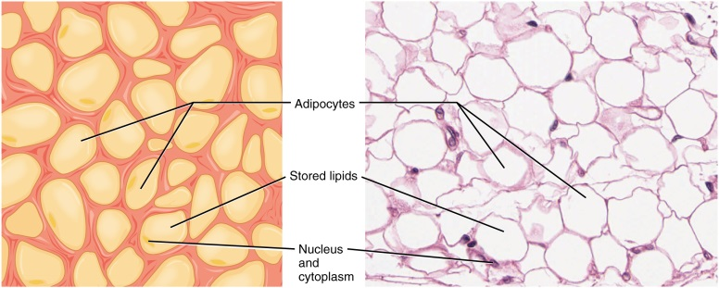
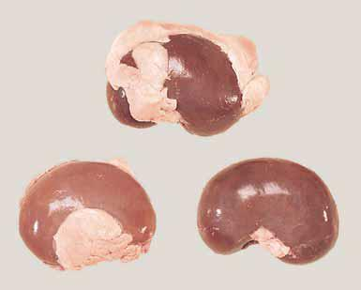
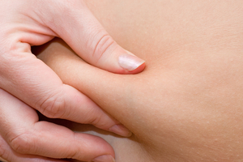
Types of connective tissue :
vii. Adipose tissue :
This tissue is found below the skin and between the internal organs.
The cells of this tissue are filled with fat globules.
Due to the storage of the fat it acts as insulator.
Prevent loss of heat and prevent from cold

